Slide 1
Mobile Application Development
Drawable Resources

Slide 2
Drawable resources
A Drawable is a general abstraction for "something that can be drawn.“
Unlike a View, a Drawable does not have any facility to receive events or otherwise interact with the user.

Slide 3
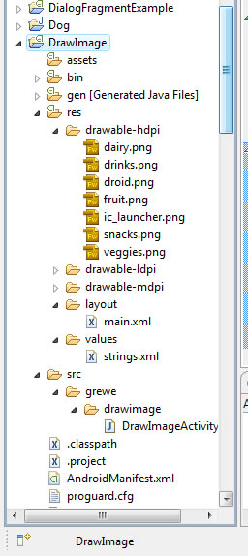
Saving Drawable resources
Drawables are saved in res/drawable/ folders
Drawable folders

Slide 4
Drawable folders
They are located in res/ folder:
res/drawable-hdpi = contains drawable resources like images for devices with a high-density screen (high dots per inch).
res/drawable-mdpi = contains drawable resources like images for devices with a medium-density screen (medium dots per inch).
res/drawable-ldpi = contains drawable resources like images for devices with a low-density screen (low dots per inch).
You can add the images to all folders or only some – the application will access them

Slide 5
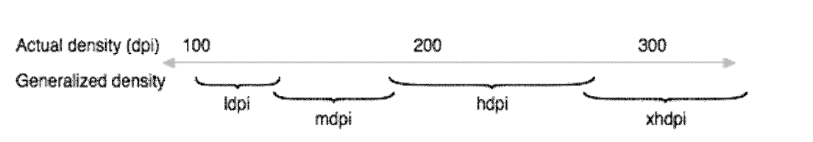
Screen Density
Screen density refers the the quantity of pixels within a physical area of the screen; usually referred to as dpi (dots per inch).
Android categorizes screen densities to low, medium, high, and extra high.
a "low" density screen has fewer pixels within a given physical area, compared to a "normal" or "high" density screen.
Android roughly maps actual screen densities to
generalized sizes as follows

Slide 6
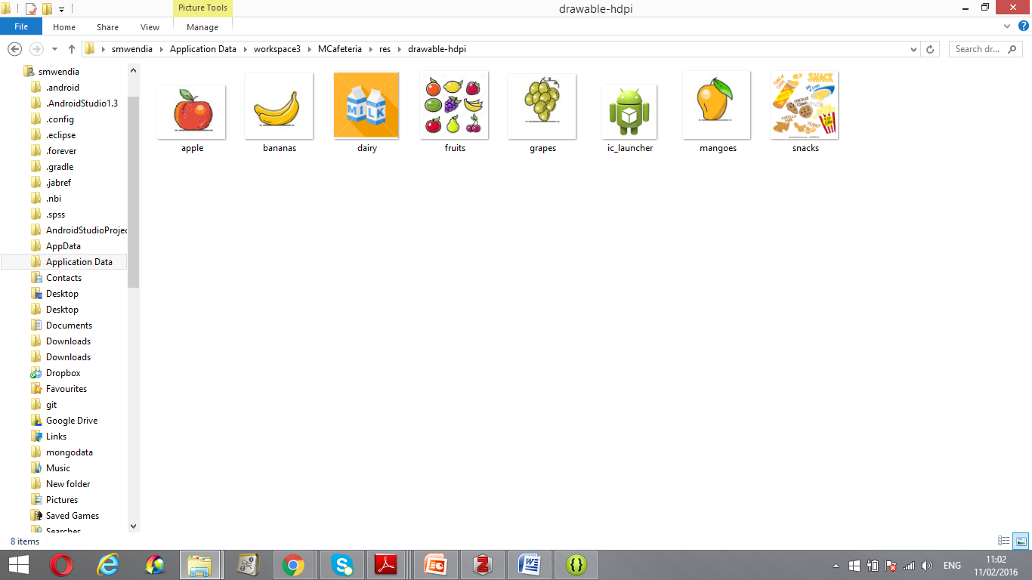
Types of Drawables
Though usually not visible to the application, Drawables may take a variety of forms:
Bitmap graphic file (.png, .jpg, or .gif).

Slide 7
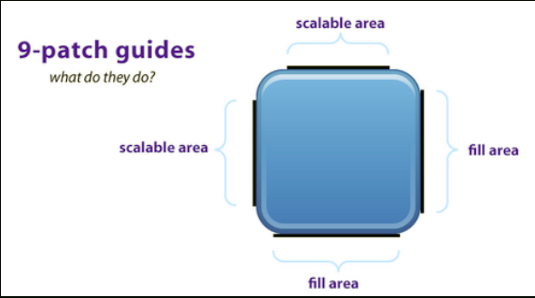
Nine-Patch Drawables
Nine Patch is an extension to the PNG format allows it to specify information about how to stretch it and place things inside of it.
It is PNG with extra pixels to define stretchable regions
And content bounds

Slide 8
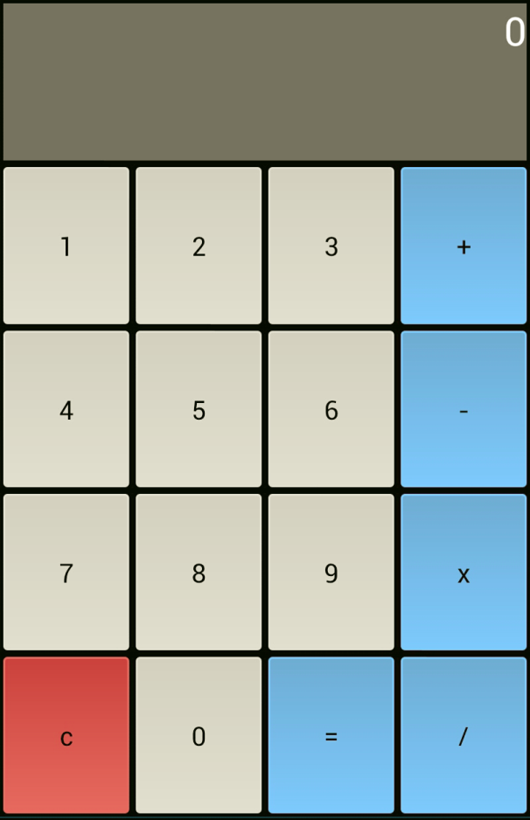
Shape
Shape class define a shape, its fill/stroke, color/ Rect, Oval,Line, Ring
Shape contains simple drawing commands instead of a raw bitmap, allowing it to resize better in some cases.

Slide 9
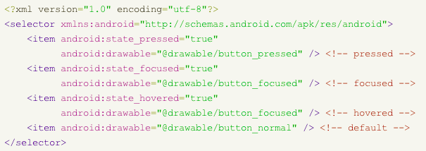
State List
State list is a compound drawable that specifies a set of drawables for different view states and selects one drawable based on its state. Examples of states: Pressed state, Enabled state, Selected state ....etc
It is mostly used for buttons

Slide 10
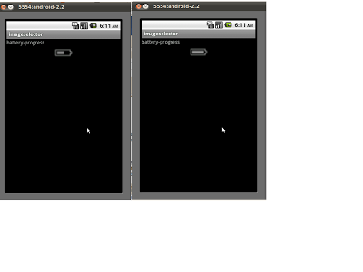
Level list
Level list is a compound drawable that selects one of a set of drawables based on its level.
It specifies a set of drawables displayed according to a level value.
LevelListDrawable.setLevel(…) method is used to change image.
Example:
A Progress bar drawable for displaying the strength of a WiFi signal. As the strength of the WiFi signal changes, the progress bar drawable that is displayed will change accordingly.

Slide 11

Layer list
Layer-list is a compound drawable, which draws multiple underlying drawables on top of each other.
It combines multiple drawables into a single drawable resource
Drawn in such a way that the last drawable is on top.
It can be used to add simple effects to existing Png drawables.
Example: Layer list

Slide 12
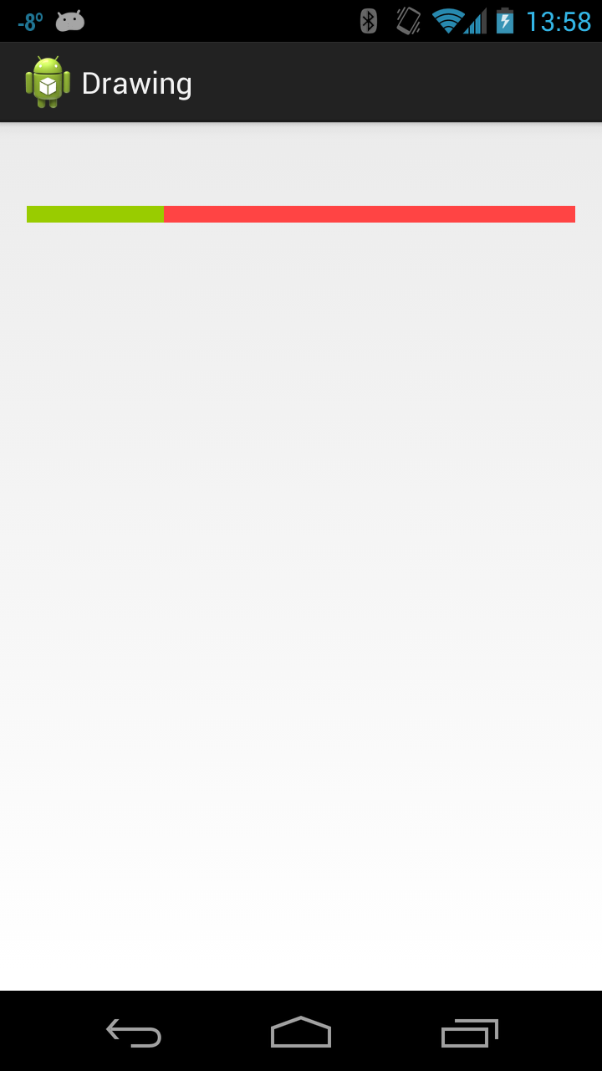
Scale Drawables
Scale is a compound drawable that changes the size of another Drawable based (i.e. Child drawable) on its current level value.
The child Drawable is changed in terms of width and height based on the level, as well as a gravity to control where it is placed in its overall container.
Most often used to implement things like progress bars.

Slide 13
Lab Exercise
Create a mobile app known as mcafeteria that contains the following views
  TextView
  ImageView –to display the image
  Button .
Create an activity known as MakeOrder

Slide 14
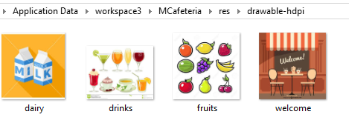
Step1: Create and save bitmap resources
Create food oriented .png images and save them in drawable-hdpi folder

Slide 15
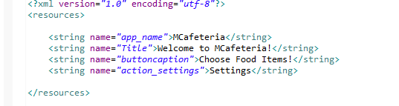
Step2: Create strings in string.xml File
Open strings.xml file that is located in res/values folder
and include two strings(title and button caption)

Slide 16
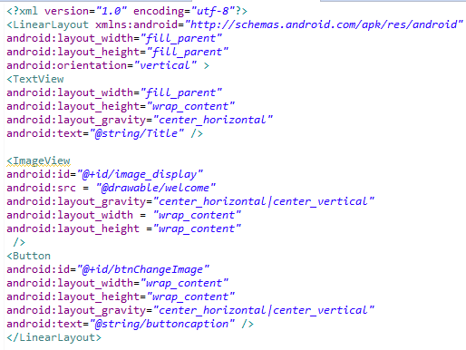
Step3: Create makeorder.xml layout file

Slide 17
ImageView element
imageView is used to displays an image
It can load images from various sources (such as resources or content providers)
takes care of computing its measurement from the image so that it can be used in any layout manager
provides various display options such as scaling and tinting.

Slide 18
Attributes of <ImageView> element
<ImageView
android:id="@+id/image_display"
android:src = "@drawable/welcome"
android:layout_gravity="center_horizontal|center_vertical"
android:layout_width = "wrap_content"
android:layout_height ="wrap_content" />
This means look for a drawable known as welcome in res/drawable /* folders for a resource named
Notice that there is no extension(.png)
It is referring to its base filename (not the extension)

Slide 19
Attributes of <ImageView> element
<ImageView
android:id="@+id/image_display"
android:src = "@drawable/droid"
android:layout_gravity="center_horizontal|center_vertical"
android:layout_width = "wrap_content"
android:layout_height ="wrap_content" />
This sets the id of the ImageView widget image_display
The id can be used in java code to reference this widget when manipulating it (e.g. changing the image to be displayed)

Slide 20
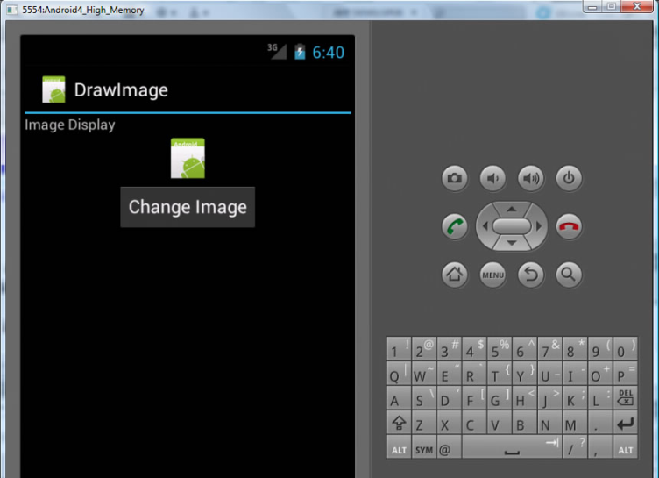
Attributes of <ImageView> element
<ImageView
android:id="@+id/image_display"
android:src = "@drawable/welcome"
android:layout_gravity="center_horizontal|center_vertical"
android:layout_width = "wrap_content"
android:layout_height ="wrap_content" />
This puts the ImageView at the center both horizontally and vertically

Slide 21
Attributes of <ImageView> element
<ImageView
android:id="@+id/image_display"
android:src = "@drawable/droid"
android:layout_gravity="center_horizontal|center_vertical"
android:layout_width = "wrap_content"
android:layout_height ="wrap_content" />
This sets the width and height to be just enough to contain the content of the ImageView
In this case, the content is the image being displayed

Slide 22
Results: A Running Application
The following figure shows an application that displays the welcome.png in the ImageView
However, the button is not interactive

Slide 23
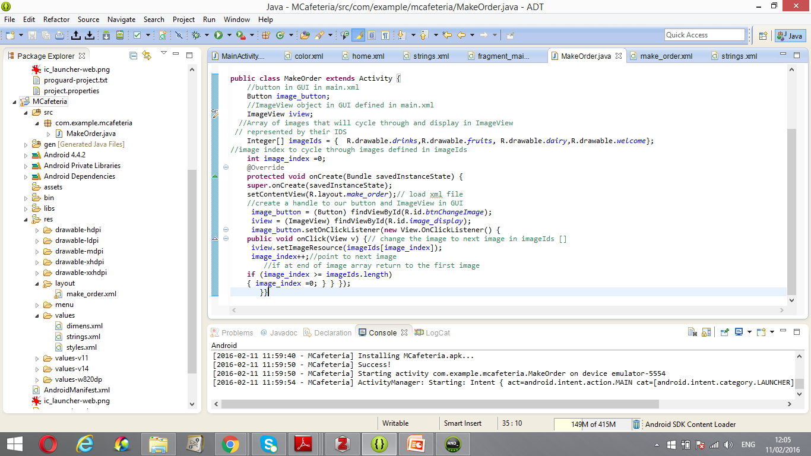
Enable interactivity: Step1 –Create class variables
Step 1: Alter our Activity file MakeOrder.java to create class variables for button (image_button) and ImageView (iview)

Slide 24

Enable interactivity : Step 2: Create an array of resources
Create class variable that is an array of resource ids representing our food images, called imageIDs[] ,create an index called image_index to loop through this array and restart to 0 when at the end of the array.)

Slide 25
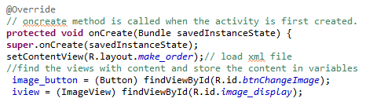
Enable interactivity : Step3: find views and initialize variables
Inside onCreate() of DrawImageActivity, find the view elements with content and store the content in variables.

Slide 26
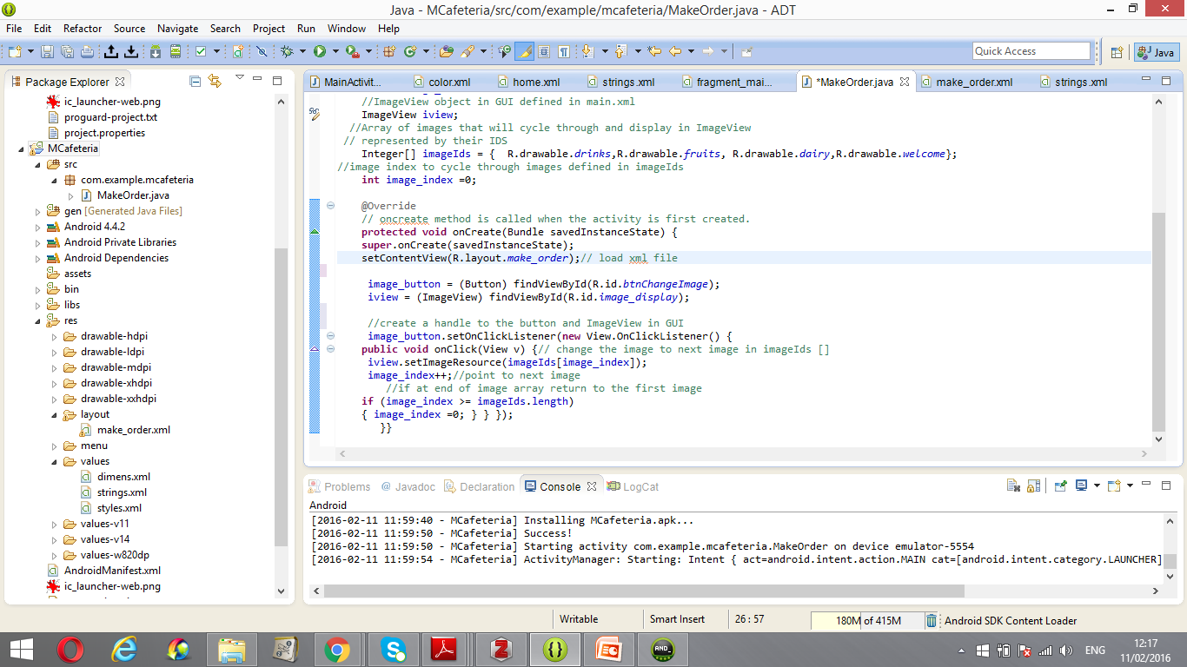
Enable interactivity :Step 4 : create an event handler
Create an event handler inside onCreate() method to handle the button and imageview

Slide 27
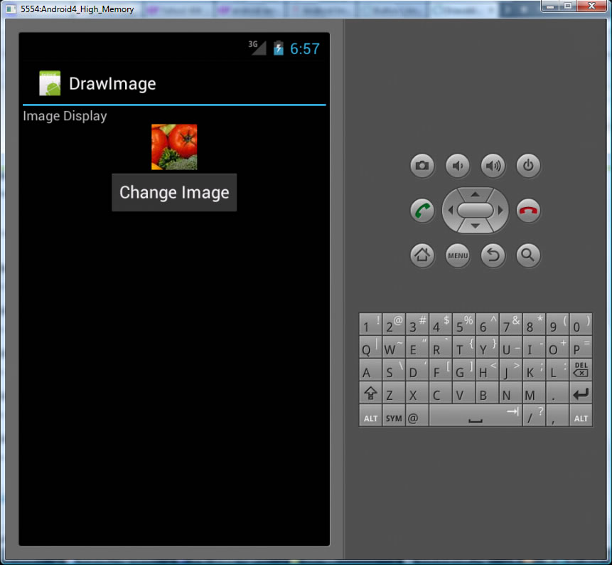
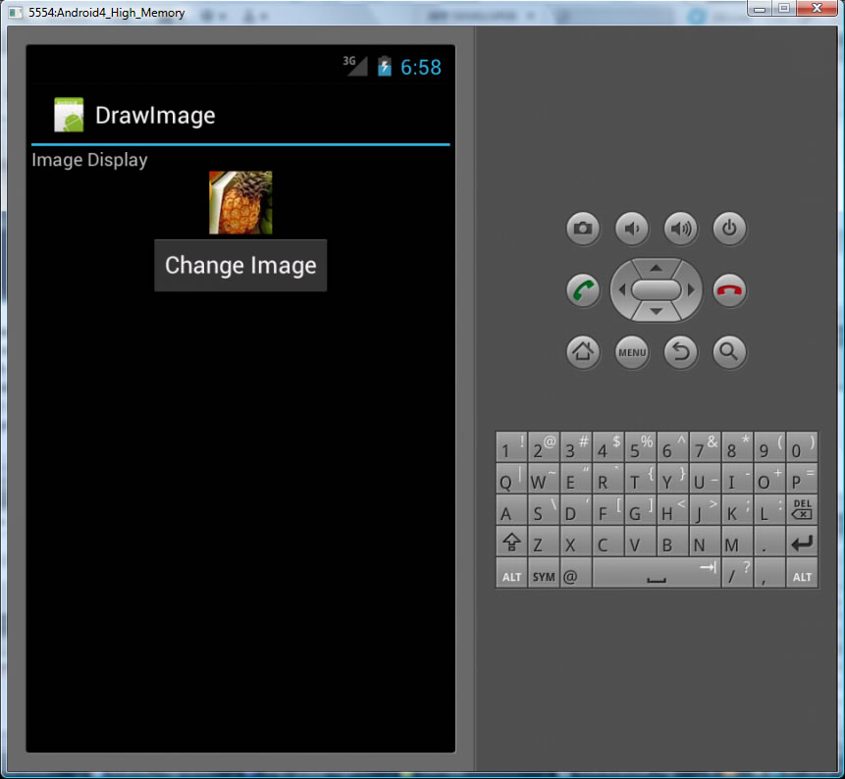
The Result

Slide 28

